Slide 1
GAMES103: Intro to Physics-Based Animation
Waves: An Intro to Fluid Dynamics
Huamin Wang
Dec 2021

Slide 2
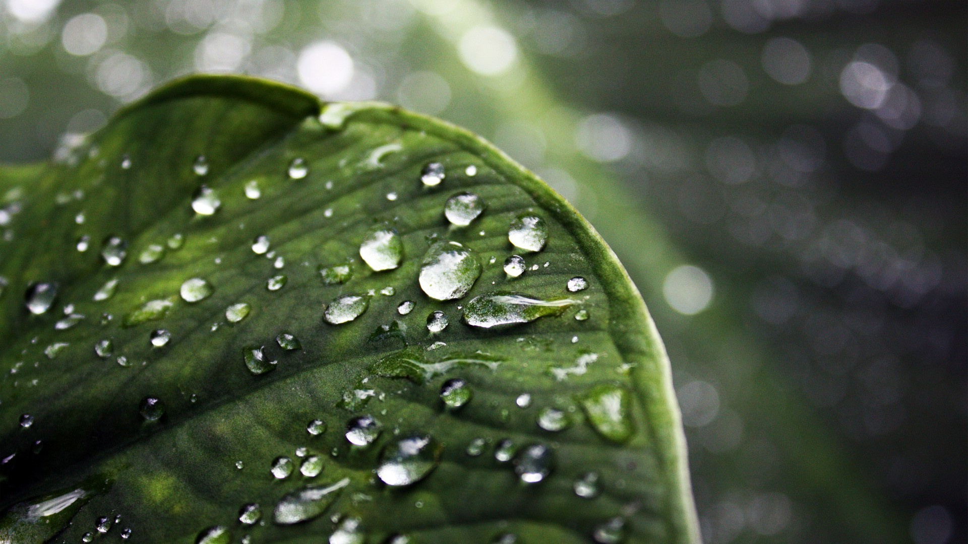
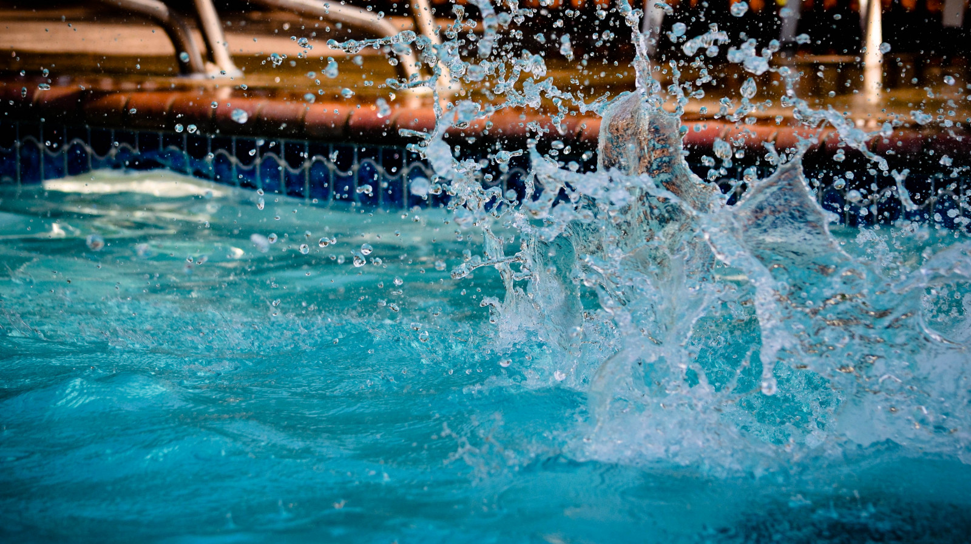
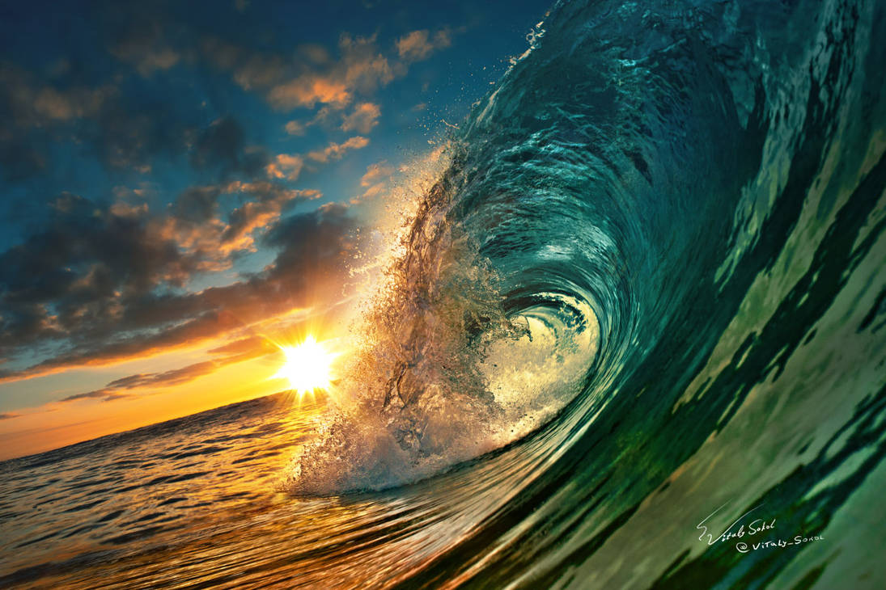
Fluid Effects
Unlike other bodies, Fluids exhibit highly volatile behaviors. As a result, it’s difficult to come up with a single, efficient way for simulating all of fluid effects.

Slide 3
Two Types of Simulation Approaches
density
velocity
temperature
Lagrangian Approach
(dynamic particles or mesh)
Node movement carries physical quantities (mass, velocity, …).
Eulerian Approach
(static grid or mesh)
Grid/Mesh doesn’t move. Stored physical quantities change.

Slide 4
A Height Field Model

Slide 5


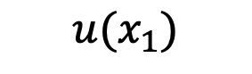





Height Field
In 2D, a (1.5D) height field is a height function $h(x)$.
$$h(x)$$
$$u(x_{1})$$
$$x$$
$$u(x_{0})$$
The velocity is also a function of $x$: $u(x)$.
$$u(x)$$
$$x_{0}$$
$$x$$
$$x_{1}$$

Slide 6
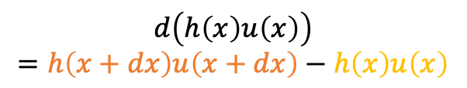
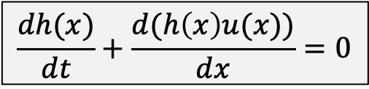


Height Field
In 2D, a height field is a height function $h(x)$.
$$\frac{dh(x)}{dt}+\frac{d(h\left(x\right)u(x))}{dx}=0$$
$$h(x)$$
$$d\left(h\left(x\right)u\left(x\right)\right)$$
$$=h\left(x+dx\right)u\left(x+dx\right)−h\left(x\right)u\left(x\right)$$
The velocity is also a function of $x$: $u(x)$.
$$u(x)$$
$$x+dx$$
$$x$$

Slide 7
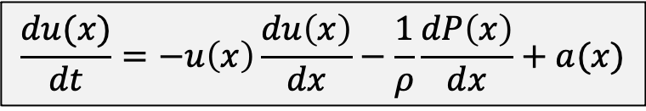



Height Field
In 2D, a height field is a height function $h(x)$.
$$\frac{dh(x)}{dt}+\frac{d(h\left(x\right)u(x))}{dx}=0$$
$$h(x)$$
The velocity is also a function of $x$: $u(x)$.
$$\frac{du(x)}{dt}=−u\left(x\right)\frac{du\left(x\right)}{dx}−\frac{1}{ρ}\frac{dP\left(x\right)}{dx}+a(x)$$
advection
external
$$u(x)$$
$$x+dx$$
$$x$$

Slide 8
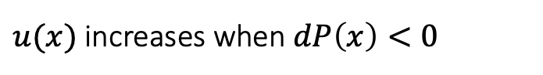
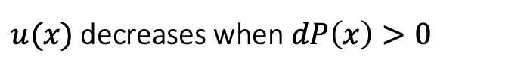
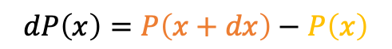
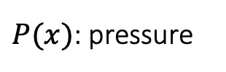
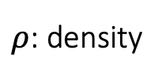
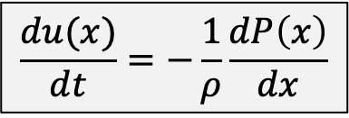


Height Field
Ignoring advection and external acceleration, we get a simple form:
$$\frac{du(x)}{dt}=−\frac{1}{ρ}\frac{dP\left(x\right)}{dx}$$
$ρ$: density
$P(x)$: pressure
$$dP\left(x\right)=P\left(x+dx\right)−P\left(x\right)$$
$$u(x)$$
$$x+dx$$
$$x$$
$u(x)$decreases when $dP\left(x\right)>0$
$u(x)$ increases when $dP\left(x\right)<0$

Slide 9
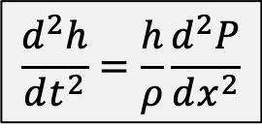
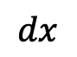
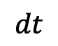
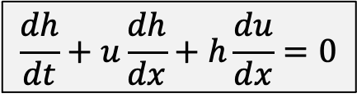
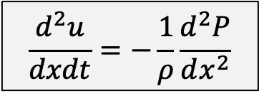
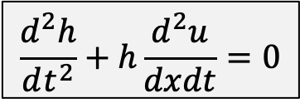
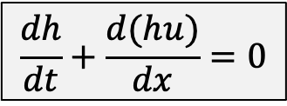
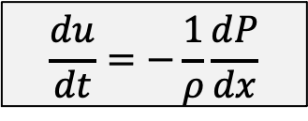
Shallow Wave Equation
We now have two equations:
$$\frac{dh}{dt}+\frac{d(hu)}{dx}=0$$
$$\frac{dh}{dt}+u\frac{dh}{dx}+h\frac{du}{dx}=0$$
$$dt$$
$$\frac{d^{2}h}{dt^{2}}+h\frac{d^{2}u}{dxdt}=0$$
$$\frac{du}{dt}=−\frac{1}{ρ}\frac{dP}{dx}$$
$$dx$$
$$\frac{d^{2}u}{dxdt}=−\frac{1}{ρ}\frac{d^{2}P}{dx^{2}}$$
We can then eliminate $u$ and formulate the shallow wave equation:
$$\frac{d^{2}h}{dt^{2}}=\frac{h}{ρ}\frac{d^{2}P}{dx^{2}}$$

Slide 10
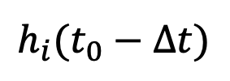
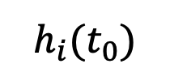
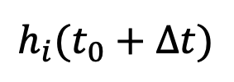
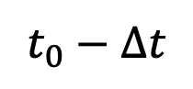
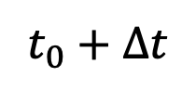
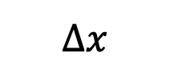
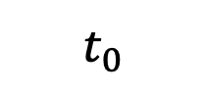
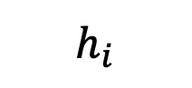
Discretization
We discretize a continuous height field into a discrete set of height columns.
$$∆x$$
$$h_{i}$$
$$h_{i}(t_{0}−∆t)$$
$$h_{i}(t_{0})$$
$$h_{i}(t_{0}+∆t)$$
$$t_{0}−∆t$$
$$t_{0}$$
$$t_{0}+∆t$$
(past)
(present)
(future)

Slide 11

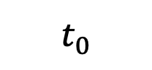
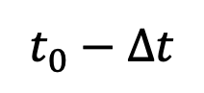
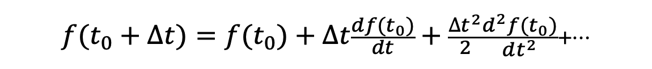
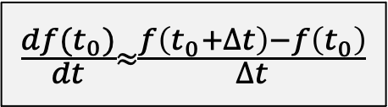
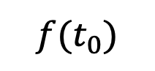
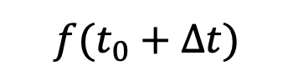
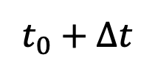
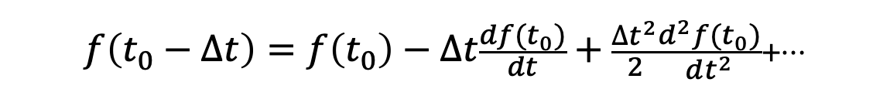
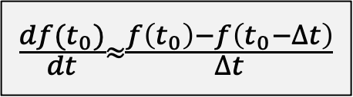
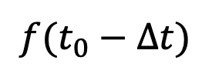
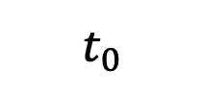
Finite Differencing
The idea of finite differencing is to use the difference to approximate the derivative.
$$f(t_{0}+∆t)=f(t_{0})+∆t\frac{df(t_{0})}{dt}+\frac{∆t^{2}}{2}\frac{d^{2}f(t_{0})}{dt^{2}}+…$$
$$f(t_{0})$$
$$f(t_{0}+∆t)$$
Forward differencing (first-order)
$$\frac{df(t_{0})}{dt}≈\frac{f\left(t_{0}+∆t\right)−f\left(t_{0}\right)}{∆t}$$
$$t_{0}$$
$$t_{0}+∆t$$
$$f\left(t_{0}−∆t\right)=f\left(t_{0}\right)−∆t\frac{df(t_{0})}{dt}+\frac{∆t^{2}}{2}\frac{d^{2}f(t_{0})}{dt^{2}}+…$$
$$f(t_{0}−∆t)$$
$$f(t_{0})$$
Backward differencing (first-order)
$$\frac{df(t_{0})}{dt}≈\frac{f\left(t_{0}\right)−f\left(t_{0}−∆t\right)}{∆t}$$
$$t_{0}−∆t$$
$$t_{0}$$

Slide 12
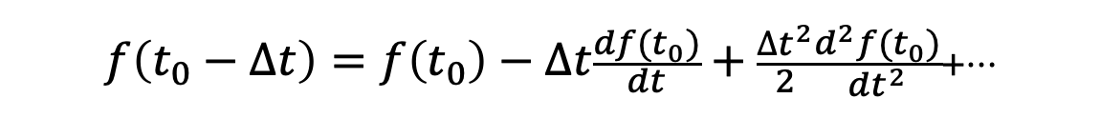
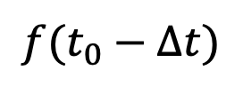
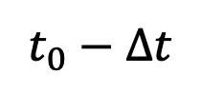
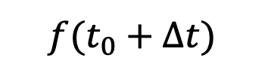
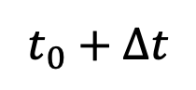
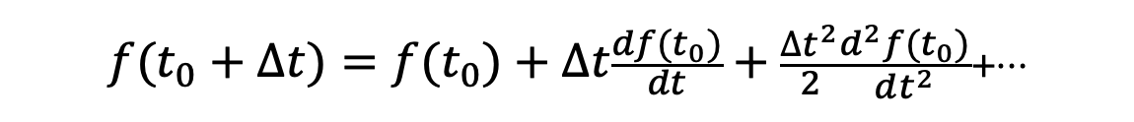
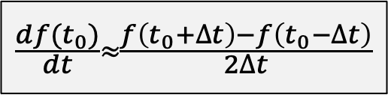

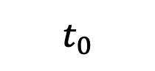
Finite Differencing
The idea of finite differencing is to use the difference to approximate the derivative.
$$f(t_{0}−∆t)$$
$$f(t_{0})$$
$$f(t_{0}+∆t)$$
$$t_{0}−∆t$$
$$t_{0}$$
$$t_{0}+∆t$$
$$f(t_{0}+∆t)=f(t_{0})+∆t\frac{df(t_{0})}{dt}+\frac{∆t^{2}}{2}\frac{d^{2}f(t_{0})}{dt^{2}}+…$$
$$f\left(t_{0}−∆t\right)=f\left(t_{0}\right)−∆t\frac{df(t_{0})}{dt}+\frac{∆t^{2}}{2}\frac{d^{2}f(t_{0})}{dt^{2}}+…$$
Central differencing (second-order)
$$\frac{df(t_{0})}{dt}≈\frac{f\left(t_{0}+∆t\right)−f\left(t_{0}−∆t\right)}{2∆t}$$

Slide 13
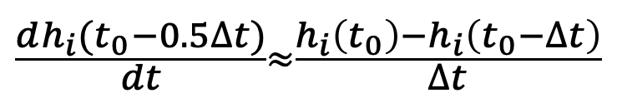
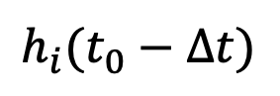






Second-Order Derivatives
We apply central differencing twice to estimate $d^{2}h_{i}/dt^{2}$.
$$\frac{dh_{i}(t_{0}+0.5∆t)}{dt}≈\frac{h_{i}\left(t_{0}+∆t\right)−h_{i}\left(t_{0}\right)}{∆t}$$
$$\frac{dh_{i}(t_{0}−0.5∆t)}{dt}≈\frac{h_{i}\left(t_{0}\right)−h_{i}\left(t_{0}−∆t\right)}{∆t}$$
$\frac{d^{2}h_{i}(t_{0})}{dt^{2}}≈\frac{\frac{dh_{i}(t_{0}+0.5∆t)}{dt}−\frac{dh_{i}(t_{0}−0.5∆t)}{dt}}{∆t}$ $≈\frac{h_{i}\left(t_{0}+∆t\right)+h_{i}\left(t_{0}−∆t\right)−2h_{i}\left(t_{0}\right)}{∆t^{2}}$
$$h_{i}(t_{0}−∆t)$$
$$h_{i}(t_{0})$$
$$h_{i}(t_{0}+∆t)$$
$$t_{0}−∆t$$
$$t_{0}$$
$$t_{0}+∆t$$
(past)
(present)
(future)

Slide 14











Second-Order Derivatives
Similarly, we apply central differencing twice to estimate $d^{2}P/dx^{2}$.
$$\frac{dP_{i+0.5}}{dt}≈\frac{P_{i+1}−P_{i}}{∆x}$$
$$\frac{dP_{i−0.5}}{dx}≈\frac{P_{i}−P_{i−1}}{∆x}$$
$\frac{d^{2}P_{i}}{dx^{2}}≈\frac{\frac{dP_{i+0.5}}{dx}−\frac{dP_{i−0.5}}{dx}}{∆x}$ $≈\frac{P_{i+1}+P_{i−1}−2P_{i}}{∆x^{2}}$
$$P_{i}$$
$$P_{i+1}$$
$$P_{i−1}$$
$$P_{i+2}$$
$$∆x$$
$$h_{i−1}$$
$$h_{i}$$
$$h_{i+1}$$

Slide 15




Discretized Shallow Wave Equation
We can now discretize the shallow wave equation $\frac{d^{2}h}{dt^{2}}=\frac{h}{ρ}\frac{d^{2}P}{dx^{2}}$.
$\frac{d^{2}h_{i}(t_{0})}{dt^{2}}$ $≈\frac{h_{i}\left(t_{0}+∆t\right)+h_{i}\left(t_{0}−∆t\right)−2h_{i}\left(t_{0}\right)}{∆t^{2}}$
$\frac{d^{2}P_{i}}{dx^{2}}$ $≈\frac{P_{i+1}+P_{i−1}−2P_{i}}{∆x^{2}}$
$$\frac{h_{i}\left(t_{0}+∆t\right)+h_{i}\left(t_{0}−∆t\right)−2h_{i}\left(t_{0}\right)}{∆t^{2}}=\frac{h_{i}}{ρ} \left(\frac{P_{i+1}+P_{i−1}−2P_{i}}{∆x^{2}}\right)$$
$$h_{i}\left(t_{0}+∆t\right)=2h_{i}\left(t_{0}\right)−h_{i}\left(t_{0}−∆t\right)+\frac{∆t^{2}h_{i}}{∆x^{2}ρ}(P_{i+1}+P_{i−1}−2P_{i})$$

Slide 16




Volume Preservation
We want the volume to stay the same. Suppose that $\sum{h_{i}\left(t\right)}=\sum{h_{i}\left(t−∆t\right)=V}$. But,
$$h_{i}\left(t_{0}+∆t\right)=2h_{i}\left(t_{0}\right)−h_{i}\left(t_{0}−∆t\right)+\frac{∆t^{2}h_{i}}{∆x^{2}ρ}(P_{i+1}+P_{i−1}−2P_{i})$$
$$\sum{h_{i}\left(t+∆t\right)=}2\sum{h_{i}\left(t_{0}\right)−}\sum{h_{i}\left(t_{0}−∆t\right)}+\sum{\frac{∆t^{2}h_{i}}{∆x^{2}ρ}(P_{i+1}+P_{i−1}−2P_{i})}$$
$$=V+\sum{\frac{∆t^{2}h_{i}}{∆x^{2}ρ}(P_{i+1}+P_{i−1}−2P_{i})}$$
This may not be zero!!!

Slide 17


Volume Preservation – Solution 1
One way to preserve volume is to modify scheme into:
$$h_{i}\left(t_{0}+∆t\right)=2h_{i}\left(t_{0}\right)−h_{i}\left(t_{0}−∆t\right)+\frac{∆t^{2}h_{i}}{∆x^{2}ρ}(P_{i+1}+P_{i−1}−2P_{i})$$
$$h_{i}\left(t_{0}+∆t\right)=2h_{i}\left(t_{0}\right)−h_{i}\left(t_{0}−∆t\right)+\frac{∆t^{2}}{∆x^{2}ρ}\left(\left(\frac{{h_{i−1}+h}_{i}}{2}\right)\left(P_{i−1}−P_{i}\right)+\left(\frac{{h_{i+1}+h}_{i}}{2}\right)\left(P_{i+1}−P_{i}\right)\right)$$
$$\sum{h_{i}\left(t+∆t\right)=}V+\frac{∆t^{2}}{∆x^{2}ρ}\sum{\left(\left(\frac{{h_{i−1}+h}_{i}}{2}\right)\left(P_{i−1}−P_{i}\right)+\left(\frac{{h_{i+1}+h}_{i}}{2}\right)\left(P_{i+1}−P_{i}\right)\right)}$$
This must be zero!!!
This is because water exchanges between $h_{i}$ and $h_{i+1}$.
$$h_{i}$$
$$h_{i+1}$$

Slide 18

After-Class Reading
Kass and Miller. 1990. Rapid, Stable Fluid Dynamics for Computer Graphics. Computer Graphics.

Slide 19


Volume Preservation – Solution 2
An easier way to preserve volume is to simply assume $h_{i}$ in the right term is constant.
$$h_{i}\left(t_{0}+∆t\right)=2h_{i}\left(t_{0}\right)−h_{i}\left(t_{0}−∆t\right)+\frac{∆t^{2}h_{i}}{∆x^{2}ρ}(P_{i+1}+P_{i−1}−2P_{i})$$
$$h_{i}\left(t_{0}+∆t\right)=2h_{i}\left(t_{0}\right)−h_{i}\left(t_{0}−∆t\right)+\frac{∆t^{2}H}{∆x^{2}ρ}\left(P_{i+1}+P_{i−1}−2P_{i}\right)$$
$$\sum{h_{i}\left(t+∆t\right)=}V+\frac{∆t^{2}H}{∆x^{2}ρ}\sum{\left(\left(P_{i−1}−P_{i}\right)+\left(P_{i+1}−P_{i}\right)\right)}$$
This must be zero!!!

Slide 20



Pressure
The pressure is related to the water height: $P_{i}=ρ{gh}_{i}$.
$$h_{i}\left(t_{0}+∆t\right)=2h_{i}\left(t_{0}\right)−h_{i}\left(t_{0}−∆t\right)+\frac{∆t^{2}H}{∆x^{2}ρ}\left(P_{i+1}+P_{i−1}−2P_{i}\right)$$
$$h_{i}\left(t_{0}+∆t\right)=2h_{i}\left(t_{0}\right)−h_{i}\left(t_{0}−∆t\right)+\frac{∆t^{2}Hg}{∆x^{2}}\left(h_{i+1}(t_{0})+h_{i−1}(t_{0})−2h_{i}(t_{0})\right)$$
Replaced by a constant $α$

Slide 21
Viscosity
Like damping, viscosity tries to slow down the waves.
$$h_{i}\left(t_{0}+∆t\right)=h_{i}\left(t_{0}\right)+\left(h_{i}\left(t_{0}\right)−h_{i}\left(t_{0}−∆t\right)\right)+α\left(h_{i+1}(t_{0})+h_{i−1}(t_{0})−2h_{i}(t_{0})\right)$$
Momentum is here.
$$h_{i}\left(t_{0}+∆t\right)=h_{i}\left(t_{0}\right)+β\left(h_{i}\left(t_{0}\right)−h_{i}\left(t_{0}−∆t\right)\right)+α\left(h_{i+1}(t_{0})+h_{i−1}(t_{0})−2h_{i}(t_{0})\right)$$
Viscosity constant

Slide 22





Algorithm
A Shallow Wave Simulator
For every cell i
$$h_{i}^{new}←h_{i}+β(h_{i}−h_{i}^{old})$$
$$h_{i}^{new}←h_{i}^{new}+α(h_{i−1}−h_{i})$$
$$h_{i}^{new} ←h_{i}^{new}+α(h_{i+1}−h_{i})$$
For every cell i
$$h_{i}^{old}←h_{i}$$
$$h_{i}←h_{i}^{new}$$

Slide 23








Boundary Conditions
A Dirichlet boundary assumes that the boundary height $H_{i+1}$ is constant. It’s considered as an open boundary.
$$h_{i−1}$$
$$h_{i}$$
$$H_{i+1}$$
$$h_{i+1}−h_{i}+h_{i−1}−h_{i}=H_{i+1}−h_{i}+h_{i−1}−h_{i}$$
A Neumann boundary specifies the boundary derivatives. For example, a zero-derivative boundary means $h_{i+1}≡h_{i}$. It’s considered as a closed boundary.
$$h_{i+1}−h_{i}+h_{i−1}−h_{i}=h_{i−1}−h_{i}$$
$$h_{i}$$
$$h_{i+1}$$
No water exchange through the boundary

Slide 24




Algorithm with Neumann Boundaries
A Shallow Wave Simulator
For every cell i
$$h_{i}^{new}←h_{i}+β(h_{i}−h_{i}^{old})$$
If $h_{i−1}$ exists, then $h_{i}^{new}←h_{i}^{new}+α(h_{i−1}−h_{i})$
$$\text{If} h_{i+1} \text{exists}\text{, }\text{then} h_{i}^{new}←h_{i}^{new}+α(h_{i+1}−h_{i})$$
For every cell i
$$h_{i}^{old}←h_{i}$$
$$h_{i}←h_{i}^{new}$$

Slide 25



Algorithm with Neumann Boundaries
Extending the simulator to 3D is also straightforward.
A Shallow Wave Simulator
For every cell i, j
$$h_{i,j}^{new}←h_{i,j}+β(h_{i,j}−h_{i,j}^{old})$$
If $h_{i−1,j}$ exists, then $h_{i,j}^{new}←h_{i,j}^{new}+α(h_{i−1,j}−h_{i,j})$
$$\text{If} h_{i+1,j} \text{exists}\text{, }\text{then} h_{i,j}^{new}←h_{i,j}^{new}+α(h_{i+1,j}−h_{i,j})$$
If $h_{i,j−1}$ exists, then${ h}_{i,j}^{new} ←h_{i,j}^{new}+α(h_{i,j−1}−h_{i,j})$
$$\text{If} h_{i,j+1} \text{exists}\text{, }\text{then} h_{i,j}^{new}←h_{i,j}^{new}+α(h_{i,j+1}−h_{i,j})$$
For every cell i, j
$$h_{i,j}^{old}←h_{i,j}$$
$$h_{i,j}←h_{i,j}^{new}$$

Slide 26
Two-Way Coupling
The coupling between a solid and a liquid should be two-way, i.e., liquid->solid and solid->liquid.

Slide 27
Two-Way Coupling
The coupling between solid and water should be two-way, i.e., water>solid and solid->water.
The key question is how to expel water out of the gray cell regions???

Slide 28




Virtual Height
The idea is to set up a virtual height $v_{i}$, so that $h_{i}^{real_new}=h_{i}−e_{i}$.
$$h_{i}−e_{i}=h_{i}+β\left(h_{i}−h_{i}^{old}\right)+α\left({v_{i+1}+h}_{i+1}+h_{i−1}−2v_{i}−2h_{i}\right)=h_{i}^{new}+α\left(v_{i+1}−2v_{i}\right)$$
$$h_{i+1}−e_{i+1}=h_{i+1}+β\left(h_{i+1}−h_{i+1}^{old}\right)+α\left(h_{i+2}+v_{i}+h_{i}−2v_{i+1}−2h_{i+1}\right)=h_{i+1}^{new}+α\left(v_{i}−2v_{i+1}\right)$$
$$v_{i}$$
$$v_{i+1}$$
$$e_{i}$$
$$e_{i+1}$$

Slide 29
Poisson’s Equation
The outcome is Poisson’s equation, with $v_{i}$ and $v_{i+1}$ being unknowns.
$$2v_{i}−v_{i+1}=\frac{1}{α}\left(h_{i}^{new}{−h}_{i}+e_{i}\right)=b_{i}$$
$$−v_{i}+2v_{i+1}=\frac{1}{α}\left(h_{i+1}^{new}{−h}_{i+1}+e_{i+1}\right)=b_{i+1}$$
$$v_{i}$$
$$v_{i+1}$$
$$e_{i}$$
$$e_{i+1}$$

Slide 30


Poisson’s Equation
The outcome is Poisson’s equation, with $v_{i}$ and $v_{i+1}$ being unknowns.
$$\left[\begin{matrix}1 & & & \\ −1 & 2 & −1 & \\ & −1 & 2 & −1 \\ & & & 1\end{matrix} \right]\left[\begin{matrix}v_{i−1} \\ v_{i} \\ v_{i+1} \\ v_{i+2}\end{matrix} \right]=\left[\begin{matrix}0 \\ b_{i} \\ b_{i+1} \\ 0\end{matrix}\right]$$
$$\left[\begin{matrix}2 & −1 \\ −1 & 2\end{matrix}\right]\left[\begin{matrix}v_{i} \\ v_{i+1}\end{matrix}\right]=\left[\begin{matrix}b_{i} \\ b_{i+1}\end{matrix}\right]$$
$$v_{i}$$
$$v_{i+1}$$
$$e_{i}$$
$$e_{i+1}$$

Slide 31









Algorithm with Coupling
A Shallow Wave Simulator
For every cell i, j
$$h_{i,j}^{new}←h_{i,j}+β(h_{i,j}−h_{i,j}^{old})$$
For every cell i, j
If $h_{i−1,j}$ exists, then $h_{i,j}^{new}←h_{i,j}^{new}+α(h_{i−1,j}−h_{i,j})$
if in contact
$$\text{If} h_{i+1,j} \text{exists}\text{, }\text{then} h_{i,j}^{new}←h_{i,j}^{new}+α(h_{i+1,j}−h_{i,j})$$
$$b_{i,j}←\frac{1}{α}\left(h_{i,j}^{new}{−h}_{i,j}+e_{i,j}\right)$$
If $h_{i,j−1}$ exists, then${ h}_{i,j}^{new} ←h_{i,j}^{new}+α(h_{i,j−1}−h_{i,j})$
$${tag}_{i,j}←true$$
$$\text{If} h_{i,j+1} \text{exists}\text{, }\text{then} h_{i,j}^{new}←h_{i,j}^{new}+α(h_{i,j+1}−h_{i,j})$$
else
$$v_{i,j}←0$$
Get v
$${tag}_{i,j}←false$$
For every cell i, j
If $h_{i−1,j}$ exists, then $h_{i,j}^{new}←h_{i,j}^{new}+αγ(v_{i−1,j}−v_{i,j})$
$$PCG_Solve(v, b, tag)$$
$$\text{If} h_{i+1,j} \text{exists}\text{, }\text{then} h_{i,j}^{new}←h_{i,j}^{new}+αγ(v_{i+1,j}−v_{i,j})$$
$γ$ is a relaxation factor.
If $h_{i,j−1}$ exists, then${ h}_{i,j}^{new} ←h_{i,j}^{new}+αγ(v_{i,j−1}−v_{i,j})$
$$\text{If} h_{i,j+1} \text{exists}\text{, }\text{then} h_{i,j}^{new}←h_{i,j}^{new}+αγ(v_{i,j+1}−v_{i,j})$$
$$h_{i,j}^{old}←h_{i,j}$$
$$h_{i,j}←h_{i,j}^{new}$$

Slide 32




Rigid Body Update
We estimate the floating force by the actual water expelled in every column.
$$f_{i}=ρg∆x(h_{i}−h_{i}^{new})$$
Or in 3D,
$$h_{i}$$
$$h_{i}^{new}$$
$$f_{i,j}=ρg∆A(h_{i,j}−h_{i,j}^{new})$$

Slide 33
A Summary For the Day
The shallow wave model simulates waves over a height field.
It’s based on a lot of simplification. We will discuss what fluid dynamics really looks like without simplification.
The strength of the shallow wave model is its simplicity and efficiency. It can easily simulate water-solid coupling too.
See Lab 4 for more details.

